Slide 1
Representing Curves and Surfaces

Slide 2
CURVES and SURFACES
Must be generated in many computer grapic applications i.e CAD,high quality char font,data plots and artists sketch.
We need to represent curves and surfaces in two cases : in modeling existing objects (car,face mountain) and in modeling from scratch where no existing object is available.
In first case we we approximate the object with pieses of planes , spheres or other shapes that are easy to describe mathematically and require that points on our model be close to the corresponding points on the object.
In second representation where there is no model user has to create its own object in the modelling process so that the object matches its description . To create the object user can either describ e it mathematically or give approximate description to be filled by some program.

Slide 3
Surface modelling
This area is quite board but we are going to discuss only three most common representations for 3D surfaces
Polygon mesh surfaces
Parametric surfaces
Quadric surfaces

Slide 4
Polygon Surfaces
A polygon mesh or unstructured grid is a collection of vertices, edges and faces that defines the shape of a polyhedral object in 3D computer graphics and solid modeling. The faces usually consist of triangles, quadrilaterals or other simple convex polygons, since this simplifies rendering, but may also be composed of more general concave polygons, or polygons with holes.

Slide 5
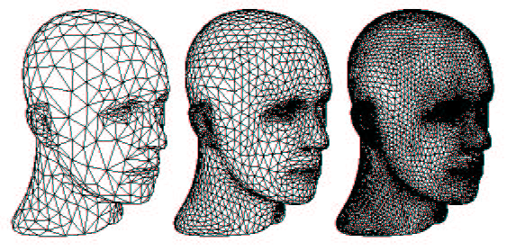
Polygon Mesh Surface

Slide 6
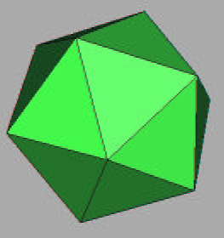
Polygon Mesh
Is a collection of edges and polygons connected such that each edge is shared by at most two polygons. An edge connects two vertices and a polygon is a closed sequence of edges.
mesh representation:
Connected triangles

Slide 7
Representing Polygon Mesh
Discuss only 3 polygon mesh representation
Explicit
Pointers to a vertex list
Pointers to an edge list

Slide 8
EXPLICIT
Each polygon is represented by a list of vertex coordinates :
P = ((x1,y1,z1),(x2,y2,z2)…..(xn,yn,zn)
The vertices are stored in the order in which they would be encountered traveling around the polygon.
There are edges between successive vertices in the list and between the last and first vertex.

Slide 9
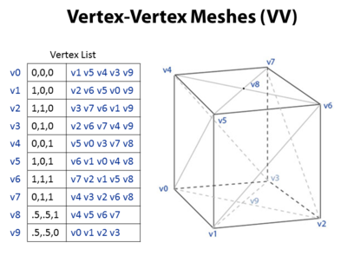
Example

Slide 10
Disadvantages
Space:Improper space utilization because of shared duplicate vertices.
Time: No explicit representation for shared edges and vertices. an interactive move of a vertex
involves finding all polygons that share the vertex
Display :Each shared edge is drawn twice causing problems on pen plotters, film recorders and video displays due to overwriting

Slide 11
Pointers to a vertex list
Used by SPHIGS , each vertex in the polygon mesh is stored just once , in the vertex list
V = (x1,y1,z1)….(xn,yn,zn)
Example : P is a list of indices into a vertex list.
P1 = (1,2,4)
P2= (4,2,3) V2
V1 V3
v4
P1
P2

Slide 12
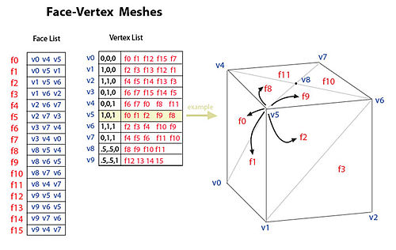
Example

Slide 13
Advantages/Disadvantages
Advantages -
Space saved because each vertex is stored once.
Coordinates of a vertex can be changed easily.
Disadvantage -
Difficult to find polygons that share edges.
Draws polygon edges twice.

Slide 14
Pointers to an Edge List
Define polygons by pointers on an edge list in which each edge occurs just once.
Each edge in the edge list points to the two vertices in the vertex list defining the edge.
We describe a polygon as P =(E1,E2….En)and an edge as E = (V1,V2,P1,P2).
When an edge belongs to only one polygon either of P1 or P2 is null.

Slide 15
Example
V = (V1,V2,V3,V4) = ((X1,Y1,Z1)……(X4,Y4,Z4)
V2
E1 E2
V1 P1 P2 E1 =(V1,V2,P1, )
E5 E3 E2 =(V2,V3,P2,)
V4 E3 = (V3,V4,)
E4 =(V4,V2,P1,P2)
E5 =(V4,V1,P1)
P1= (E1,E4,E5)
P2 =(E2,E3,E4)

Slide 16
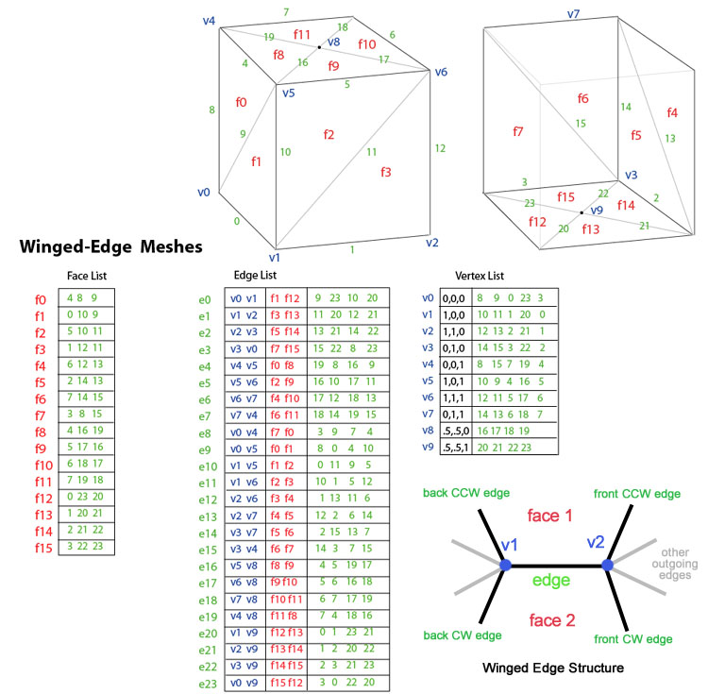
Example

Slide 17
Advantages -
Displays edges rather than polygons.
Eliminates redundant clipping, transformation and scan conversion.
Filled polygons are more easily clipped.
In all three cases, the determining of which edges are incident to a vertex is not easy. All edges must be inspected

Slide 18
Plane Equation
The plane equation can be found by using the
coordinates of three vertices.
Ax + By + Cz+D= 0
Where A, B, and C define the normal to the plane and (x, y, z) is any point on the plane.
The planes normal can be computed as the cross
product between three points on the plane
P1P2 X P1P3
A nonzero cross product defines a plane and D can be found by substitution.
If the cross product is zero then the three points are collinear.
Other vertices , if any can be used.

Slide 19
Plane Equations,another technique for finding coefficients A,B and C cont..
It can be shown that A,B and C are proportional to the signed areas of the projections onto the
(y,z) ,(x,z) and (x,y) planes respectively.
For polygon parallel to the (x,y) plane , A=B=0 , the projection onto the (y,z) and (x,z) planes have zero area

Slide 20
Calculating C for given Example
The area C of the polygon projected onto the (x,y) plane = area of A3- Area(A1)-Area(A2)
C= ½∑(yi + Yi℗1)(xi ℗1-xi)
Where ℗ is normal addition except that n ℗1=1.
C= ½(y1+y2)(x2-x1)+1/2(y2+y3)(x3-x2)+1/2(y3+y1)(x1-x3)
|_____-A1____| |_____-A2______| |____A1+A2+A3__|
Sign of sum is +ve if vertices have been
enumerated in clockwise direction
otherwise it is -ve
(x3,y3) (x1,y1)
A3
A1
A2 (X2,y2)

Slide 21
Distance D
We can estimate o how nonplanar the polygon is by calculating the perpendicular distance from the plane to each vertex.
The distance d for the vertex at (x,y,z) is
d= Ax+By+Cz+D/ sqrt(A²+B²+C²)
The distance is either +ve or –ve depending on which side of the plane the point is located.
If vertex is on the plane then d=0.
Any nonzero multiplicative const. can changes the equation but not the plane.
Thus Store plane coefficient with normalized normal k = 1/ sqrt(A²+B²+C²)

Slide 22
Parametric polynomial cubic curves
Define points on a 3D curve by using 3 polynomials in a parameter t, one for each x,y and z. The coefficient of polynomials are selected such that the curve follows the desired path.
Although various degree of polynomials can be used we will discuss only cubic polynomials i.e that have powers of parameters upto third degree.
Term cubic curves will often be used for such curves

Slide 23
Parametric Cubic Curves
Polylines and polygons are first degree piecewise linear approximation to curves and surfaces , respectively.
If the curves and surfaces we want to model are not piecewise linear we need to create and store large number of endpoints to achieve accuracy.
Moreover interactive manipulation of data is tedious since we have to manipulate so many points

Slide 24
Parametric Cubic Curves
First Method: Express y and z as explicit function of x , so that y = f(x) and z = f(y).
Difficulties :
Impossible to get multiple values of y for a single x , so curves like circle and ellipse must be represented by multiple curve segments.
Above def^{n}. is not rotationally invariant9 to describe rotated version of the curve require great deal of work and may require breaking a curve segment into many others).
Describing curves with vertical tangent is difficult , because a slope of infinity is difficult to represent

Slide 25
Parametric Cubic Curves
Second Method : we model curves as solutions to implicit equations of the form
f(x, y, z)=0.
Difficulties : given equation have more solutions than we want. Ex : suppose we want to model circle using equation x2+y2 =1 whis is Ok but what if we want to model half circle for it we need to add constraints such as x>=0 which cannot be contained in the implict equation.
Furthermore if we join two implicit curve segments it is difficult to tell whether their tangent directions agree at the join point or not . Tangent continuity is critical in many applications.

Slide 26
Parametric Cubic Curves
Parametric representation of curves x = x(t) and y= y(t) overcome problems caused by above two forms.
A curve is approximated by a piecewise polynomial curve instead of piecewise linear curve used before.
Each segment of the overall curve is given by three functions x,y and z which are cubic polynomials in the parameter t.
Cubic polynomials are most often used because lower degree polynomials give too little flexibility whereas higher degree polynomials give unwanted wiggles and require more computations.

Slide 27
Parametric Cubic Curves
Given a cubic polynomial with 4 coefficients four knows are used to solve for the unknown coefficients.
The 4 knows might be the two endpoints and the derivatives at the endpoints.
The cubic polynomials that define a curve segment Q(t) = [x(t)y(t)z(t)] are of the form
x(t) = a_{x}t³ + b_{x}t² + c_{x}t + d_{x}
y(t) = a_{y}t³ + b_{y}t² + c_{y}t + d_{y}
z(t) = a_{z}t³ + b_{z}t² + c_{z}t + d_{z} , 0<=t<=1

Slide 28
Parametric Cubic Curves
With T = [t³ t² t 1] and defining matrix of coefficients of the three polynomials as
C =
Equations in previous slide can be rewritten as
Q(t) = [x(t) y(t) z(t) ] = T.C
The derivative of Q(t) is the parametric tangent vector of the curve.
d/dtQ(t) = [d/dt x(t) d/dt y(t) d/dt z(t)]= d/dt T.C
Q’(t) = [3t2 2t 1 0].C
=[3a_{x}t² +2b_{x}t +c_{x} 3a_{y}t² +2b_{y}t +c_{y} 3a_{z}t² +2b_{z}t +c_{z} ]
a_{x} | a_{y} | a_{z}
b_{x} | b_{y} | b_{z}
c_{x} | c_{y} | a_{z}
d_{x} | d_{y} | d_{z}

Slide 29
Parametric Cubic Curves
Continuity : To ensure a smooth transition from one section of a piecewise parametric curve to the next we can impose various continuity conditions at the connection points
Kinds of continuity:
G0: two curve segments join together
i.e the value of x,y,z at join point for the first curve section is equal respectively to the values of x1,y1,z1 evaluated at same join point for the next curve
-- C0: same as G0.
G1: directions of tangents are equal at the joint(not necessarily magnitude)
C1: directions and magnitudes of tangents are equal at the joint
Cn: directions and magnitudes of n-th derivative are equal at the joint( for c2 both I & II derivatives of the two curve sections are equal at the intersection , for G2I & II derivatives of the curve section are proportional at their boundary

Slide 30
Parametric Cubic Curves
The blending function B are given by
B = M · T.
Q(t) = G ⋅ B
A curve segment Q(t) is defined by constraints on endpoints,tangent vectors and continuity between curve segments.

Slide 31
Parametric Cubic Curves
Three major curve types:
Hermite -
defined by two endpoints and two endpoint tangent vectors.
Bézier -
defined by two endpoints and two other points that control
the endpoint tangent vector.
Splines
several kinds, each defined by four points
uniform B-splines, non-uniform B-splines, ß-splines

Slide 32
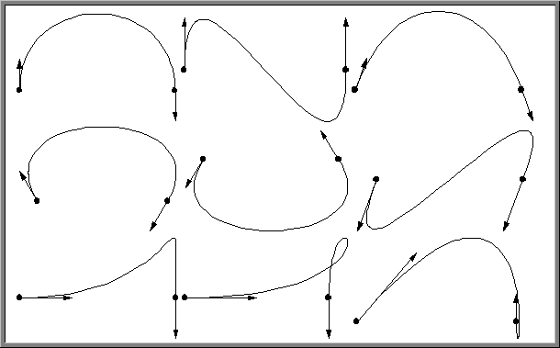
Cubic Hermite Curves
The following nine curves are defined by a Hermite characteristic matrix.
The points represent the endpoint parameters, and the arrows point in the direction of the tangent vectors. Note that the arrow lengths do not correspond to the tangent vector magnitudes

Slide 33
Cubic Hermite Curves
We define the Hermite basis matrix, M_{H}, which relates the endpoints and tangent vectors on the hermite curve to the polynomial coefficients.
Multiplying the Hermite geometry matrix, G_{H}, with M_{H}, effectively transforms G_{H} from the Hermite geometry to produce the coefficients, C_{H}, of the parametric function Q_{H}(t).
Recall that the coefficients of the function Q_{H}(t) are described by the coefficient matrix, C_{H}
C_{H} = M_{H} · G_{H,} Since Q(t) = T · C. Therefore, Q_{H}(t) = T · C_{H .}

Slide 34
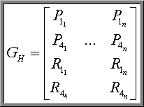
Cubic Hermite Curves
Defining G_{H}
Where n is the dimension of the curve
The elements P₁ and P₄ are the t = 0 and t = 1 positions of the curve. R₁ and R₄ are the t = 0 and t = 1 tangent vectors.
The x component of the Hermite geometry matrix , as G_{Hx =}
P1
P4
R1
R4

Slide 35
Cubic Hermite Curves
Since Q_{H}(t) = T · C_{H}.
We can evaluate the function at t = 0 and t = 1 to find the Hermite basis matrix that transform the P₁ and P₄ rows of the geometry matrix:
Q_{Hx}(t) = a_{x}t³ + b_{x}t² + c_{x}t + d_{x} = T.C_{x} =T · M_{H} · G_{Hx}
=[ t³ t² t 1 ] · M_{H} · G_{Hx}
Constraints on x(0) and x(1) are found by direct substitution
x(0) = P_{1x} = a(0)³ + b(0)² + c(0) + d = T · M_{H} · G_{Hx} = [ 0 0 0 1 ] · M_{H} · G_{Hx}
x(1) = P_{4x} = a(1)³ + b(1)² + c(1) + d = T · M_{H} · G_{Hx} = [ 1 1 1 1 ] · M_{H} · G_{Hx}

Slide 36
Cubic Hermite Curves
Differentiating x’(t) = [3t² 2t 1 0]M_{H}. G_{Hx}
x'(t) = 3at² + 2bt + c = T · M_{H} · G_{H} = [ 3t² 2t 1 0 ] · M_{H} · G_{H}
x'(0) = R_{1x} = 3a(0)² + 2b(0) + c = T · M_{H} · G_{H} = [ 0 0 1 0 ] · M_{H} · G_{Hx}
x'(1) = R_{4x} = 3a(1)² + 2b(1) + c = T · M_{H} · G_{H} = [ 3 2 1 0 ] · M_{H} · G_{Hx}

Slide 37
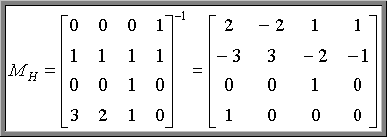
Cubic Hermite Curves
The four constraints of equation can be rewritten in matrix form as
= GHX = M_{H} · G_{Hx}
MH must be the inverse of the 4X4 matrix
P1
P4
R1
R4
0 | 0 | 0 | 1
1 | 1 | 1 | 1
0 | 0 | 1 | 1
3 | 2 | 1 | 0

Slide 38
Cubic Hermite Curves
Expanding the product T · M_{H} in Q(t) = T · M_{H} · G_{Hx}
Hermite blending function Q(t) = T. M_{H} · G_{H} = B_{H}.G_{H}
= (2t³ - 3t² + 1)P1 + (-2t³ + 3t² )P4 + (t³ - 2t² + t)R1 + (t³ - t² ) R4
This efficient representation of the Hermite form allows the parametric function coefficients to be calculated in a single matrix multiplication.
Unfortunately the magnitudes of the tangent vectors are somewhat of a mystery.
Often the magnitudes need to be determined by trial and error, as a very large magnitude may be required to perturb the curve a small amount, or a small magnitude perturbs the curve too much.
It is this problem that leads us to a more useful form of the parametric cubic curve: the Bezier form

Slide 39
Continuity Cond. For Hermite Curve
For two Hermite curves to share a common endpoint with G1 continuity the geometry vector must have the form
[P1 P4 R1 R4] and [P4 P7 kR4 R7] with k>0
There must be a shared endpoint P4 and tangents with at least equal directions
C1 continuity requires k=0 so the tangent vector direction and magnitude must be equal

Slide 40
Cubic Bézier Curves
The Bezier form of the parametric cubic curve solves the problem that plagued the Hermite form: it provides a mechanism for relating the tangent vector magnitudes to points in space.
The endpoints, P₁ and P₄, and the intermediate points, P₂ and P₃, of the Bezier geometry are resolved into the tangent vectors R₁ and R₄ of the Hermite geometry.
The Bézier geometry matrix GB consists of four control points.

Slide 41
Cubic Bézier Curves
To help understand the effects of the intermediate control points, we will walk through the evaluation of the Bezier curve function Q_{B}(t).
When t = 0, the function evaluates to the point P₁.
As t increases, the curve moves towards the other endpoint, P₄, in a straight line (it is, after all, the shortest path between the two points).
However, the intermediate control points deform this straight line. When t = .01, the value of the intermediate point P₂ has more influence on the curve than the intermediate point P₃.
As t increases to .4, the intermediate control point P₂ still has more control over the curve than P₃.
At t = .5, the intermediate points have equal influence over the curve.
When t > .5, the control point P₃ has the greater influence.

Slide 42
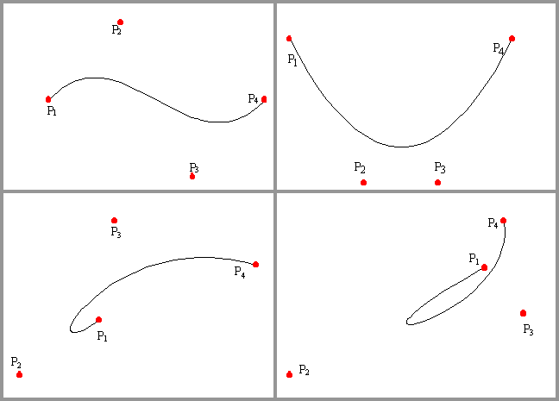
Cubic Bézier Curves
intermediate control points deforming the line P₁P₄as you consider the following curves.

Slide 43
Cubic Bézier Curves
The Bézier geometry matrix GB consists of four control points. G_{B} = [P1 P2 P3 P4 ]
The starting and ending tangent vectors are determined by the vectors P1P2 and P3P4 and are related to R1 and R4 by
R1 = Q’(0) = 3(P2-P1) , R4 = 3(P4-P3)
Bézier curve interpolates the two control points and approximate the other two.
The Bézier Geometry matrix G_{B} consist of four points G_{B} = [P1 P2 P3 P4]

Slide 44
Cubic Bézier Curves
Let M_{HB} the conversion matrix that define the relation between the Hermite geometry vector and the Bezier gemeotry vector.
G_{H} = =
= M_{HB}. G_{B}
To find Bezier Basis Matrix M_{B} we use Hermite curve equation and substitute G_{H} = M_{HB}. G_{B} and define M_{B} =M_{H} . M_{HB}
P1
P4
R1
R4
1 | 0 | 0 | 0
0 | 0 | 0 | 1
-3 | 3 | 0 | 0
0 | 0 | -3 | -3
P1
P2
P3
P4

Slide 45
Cubic Bézier Curves
Q(t) = T. M_{H} .G_{H} = T. M_{H} .(M_{HB}.G_{B}) = T. (M_{H} .M_{HB}). G_{B}
= T. M_{B}.G_{B}
Multiplying M_{H} .M_{HB} gives
M_{B} = M_{H} .M_{HB} =
And the product Q(t) = T. M_{B}.G_{B}
Q(t) =(1-t)³P1 +3t(1-t)²P2+3t²(1-t)P3+t³P4
The four polynomials B_{B} = T. M which are the weights in above Eq. are called the Bernstein polynomial
-1 | 3 | -3 | 1
3 | 6 | 3 | 0
-3 | 3 | 0 | 0
1 | 0 | 0 | 0

Slide 46
Cubic Bézier Curves
Properties of the Bézier Curve
The blending functions -
are non-negative and they all sum to unity
Convex hull property -
for t∈[0,1], each curve segment is completely within the convex hull of the four control points.
Symmetry
Endpoint interpolation
A Bézier curve can have C0 and C1 continuity at the join points
(the three points must be distinct and collinear)

Slide 47
Continuity of Bezier Curve
G1 continuity is provided at the endpoint when P3-P4= k(P4-P5),k>0.That is, the three points P3,P4 and P5must be distinct and collinear.
When k=1 , there is C1 continuity in addition to G1.
If we refer the polynomials of two curve segments as xl(fr left segment) and xr(fr right segment) we can find C0 andC1 continuity conditions at their join point.
Xl(1) =xr(0) =d/dtxl(1)=d/drxr(0)

Slide 48
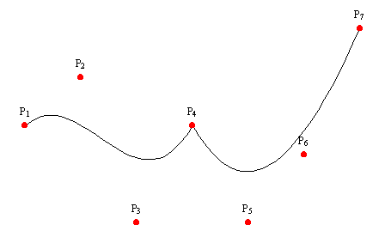
C0 continuity

Slide 49
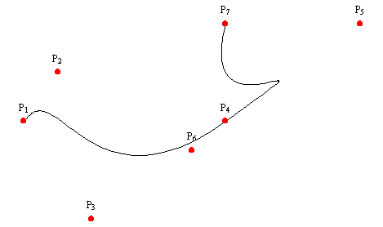
C1 continuity

Slide 50
Continuity of Bezier Curve
For x component
Xl(1)=xr(0)=P4x
d/dt(xl(1)=3(P4x-P3x)
d/dtxr(0)=3(P5x-P4x)
Same conditions are true for y and z
Fr C0 and C1 continuity P4-P3 = P5-P4
This scheme allows the joining of Bezier curves with first degree continuity. There is no evident relationship between the Bezier control points and the second derivative of the curve. C², the second degree of continuity, is achieved when the acceleration of the curves are equal at the joints. We introduce a new form of the parametric cubic curve that achieves C² continuity: the B-spline.

Slide 51
Summary of Bezier and Hermite Curves
offer local control
offer C₁ continuity
interpolates (some) control points

Slide 52
SPLINE REPRESENTATION
In Drafting terminology a spline is a flexible strip used to produce a smooth curve through a designated set of points.
Several small weights are distributed along the length of the strip to hold it in position on the drafting table as the curve is drawn.
The term SPLINE CURVE originally reffered to a curve drawn in this manner

Slide 53
SPLINE REPRESENTATION
We can describe a spline with piecewise cubic polynomial function whose first and second derivatives are continuous across the various curve sections.
The term Spline curve now refers to any composite curve formed with polynomial section satisfying continuity condition at the boundary of the pieces.
A Spline surface can be described by a two set of orthogonal spline curves

Slide 54
SPLINE REPRESENTATION
APPLICATIONS
Design curve and surface shapes.
Digitize drawing for computer storage.
To specify animation path.
CAD Applications

Slide 55
SPLINE REPRESENTATION
We specify a Spline by giving a set of co-ordinate points called control points, which indicates the general shape of the curve.
These control points are fitted with piecewise contineous parametric polynomial function in one of the two ways
Curve passing through each control point → curve is said to interpolate control points.
Not necessarily pass through each control point → curve is said to approximate control points.
A spline curve is defined ,modified and manipulated with operations on the control points

Slide 56
Cubic B-Splines
Uniform Non-rational B-Splines
– Knot are spaced at equal interval of the parameter t.
● Non-uniform Non-rational B-Splines
– The parameter interval between the knot values is not necessarily uniform.
● Non-uniform Rational B-Splines (NURBS)

Slide 57
Uniform Nonrational B-Spline
The natural cubic spline is the first spline to be developed for graphic application.
Have C0 , C1 and C2 continuous cubic polynomials that interpolates the control points.
Polynomial coefficients are dependent on all control points , thus calculation involve inverting an n+1 by n+1 matrix.
Disadvantages :
--moving away any control point effects the entire curve.
--Computation time needed to invert the matrix can interfere with the interactive reshaping of curve

Slide 58
Uniform Nonrational B-Spline
B Splines : Consist of curves whose polynomial coefficents depend on just few control points. called local control.
Time to compute coefficients is greatly reduced.
Same continuity as natural splines but do not interpolate their control points.
Cubic B-Splines approximate a series of m+1 control points P0,P1…. Pm,m>=3 with a curve consisting of (m-2) cubic polynomial curve segments Q3,Q4….Qm.

Slide 59
Uniform Nonrational B-Spline
Each curve segment is defined in its own domain 0<=t<=1,we can adjust the parameter so that the parameter domains for the various curve segments are sequential.
If there is a join point or knot between Qi-1 and Qi at the parameter ti, the parameter value at such a point is called a knot value.
The initial and final points are also knots, so there is a total of m-1 knots.
Term Uniform means that the knots are spaced at equal intervals of the parameter t

Slide 60
Uniform Non-rational B-Splines
For each i ≥ 4 , there is a knot between Q_{i-1} and Q_{i} at t = t_{i}.
Initial points at t₃ and t_{m+1} are also knots. The following illustrates an example with control points set P₀ … P₉:
Knot.
Control point.
m=9 (10 control points)
m-1 knots
m-2 knot intervals.

Slide 61
Uniform Non-rational B-Splines
First segment Q₃ is defined by point P₀ through P₃ over the range t₃ = 0 to t₄ = 1. So m at least 3 for cubic spline.
Knot.
Control point.
P1
P3
m=9 (10 control points)
m-1 knots
m-2 knot intervals.
Q₃
P0
P2

Slide 62
Uniform Non-rational B-Splines
Second segment Q₄ is defined by point P₁ through P₄ over the range t₄ = 1 to t₅ = 2.
Knot.
Control point.
P1
P3
P4
m=9 (10 control points)
m-1 knots
m-2 knot intervals.
Q₄
P2

Slide 63
Cubic B-Splines
We have talked about a bi-infinite set of splines. What does this look like?
The unweighted B-Splines are shown for clarity.
How does a weighted set affect the shape of the curve?
4
8
12
t

Slide 64
Generating a Curve
X(t)
Opposite we see an example of a shape to be generated.
Here we see the curve again with the weighted B-Splines which generated the required shape.
t
t

Slide 65
B-Spline Example
A closed curve is rather like a bi-infinite set – a periodic set of N knots in which: for all i, t_{i+N} = t_{i} and t_{i} = i for i = 0..N-1
Consider a closed curve with 5 control points with 5 knots. N=5, ie. x_{–1}≡ x_{4,} etc.
Control points are: x₀ = (2,0); x₁ = (1,1); x₂ = (-1,1); x₃ = (-1,-1) and x₄ = (1,-1).

Slide 66
B-Spline Example
Draw the interval: t = [4..5] , the others are handled the same way.
x₁
x₄
x₂
x₁
x₀
x₃
x₄

Slide 67
How Smooth is a B-Spine?
Smoothness increases with order k in B_{i,k}
Quadratic, k = 3, gives up to C₁ order continuity.
Cubic, k = 4 gives up to C₂ order continuity.
However, we can lower continuity order too with Multiple Knots, ie. t_{i} = t_{i+1}= t_{i+2} = … Knots are coincident and so now we have non-uniform knot intervals.
A knot with multiplicity m is continuous to the (k-1-m)th derivative.
A knot with multiplicity k has no continuity at all, ie. the curve is broken at that knot.

Slide 68
B-Spline Continuity Example
P0
P2
First knot shown with 4 control points, and their convex hull.
P1
P3

Slide 69
B-Spline Continuity Example
P0
P2
P4
First two curve segments shown with their respective convex hulls.
Centre Knot must lie in the intersection of the 2 convex hulls.
P1
P3

Slide 70
Repeated Control Point
P0
P3
First two curve segments shown with their respective convex hulls.
Knot is forced to lie on the line that joins the 2 convex hulls.
Curve is only C₁ continuous
P1=P2
P4

Slide 71
Triple Control Point
First two curve segments shown with their respective convex hulls.
Both convex hulls collapse to straight lines – all the curve must lie on these lines.
Curve is only C₀ continuous
(Curiously it is actually C₂ continuous because tangent vector magnitude falls to zero at join. )
P0
P4
P1=P2=P3

Slide 72
Nonuniform Nonrational B-Spline
The parameter interval between successive knot values need not be uniform.
Nonuniform knot means that the blending function no longer be same for each interval but rather vary from segment to segment.
Advantage over Uniform B-Spline:
Reduced continuity : C2 to C1 to C0
If C0 continuity then curve interpolates a control point without the undesirable effect of uniform B-splines( curve segment on either side of the interpolated control point are straight line)
Possible to add additional knot and control point so that resulting curve can be easily reshaped.
Knot value seq. is a non decreasing seq of knot values t0 through tm+1 , which allows successive knot values to be equal

Slide 73
Nonuniform Nonrational B-Spline
When knot values are equal the parameter value is called a multiple knot and the number of identical parameter values is called the multiplicity of the knot.
Consider the knot sequence (0,0,0,0,1,1,2,3,4,4,5,5,5,5)
The knot value o has multiplicity four
1 has multiplicity 2
4 has multiplicity 2
5 has multiplicity 4

Slide 74
Summary of B-Splines
Functions that can interpolate a series of control points with C₂ continuity and local control.
Don’t pass through their control points, although can be forced.
note that if an order k B-Spline has k points locally colinear then a straight-line section will result midway in the set, and will touch (tangentially) the convex hull for (k – 1) colinear control points.
Uniform
Knots are equally spaced in t.
Non-Uniform
Knots are unequally spaced
Allows addition of extra control points anywhere in the set.

Slide 75
B-Spline Summary Continued
For interactive curve modelling
B-Splines are very good.
To interpolate a number of positions
Catmull-Rom splines are best.
To interpolate with tangent control
Hemite or Bézier forms are useful and most often used.
To draw a spline.
Brute force method : Evaluate matrix to get parametric expressions for coordinates. Then for small increments of t, join with line segments.
Better : use method of forward differences to express spline in Δt form.

Slide 76
Nonuniform Rational Cubic Poly. Curve Segments
General rotational cubic curve segments are ratio of polynomials
x(t) = X(t)/w(t),y(t) = Y(t)/w(t) ,z(t) = Z(t)/w(t)
X(t),Y(t),Z(t) → cubic poly. Having control points defined in homogeneous co-ordinates.
The poly. In rational curves can be Bezier, Hermite or any other type.
Rational curves are invarient under rotation, scaling, translation and perspective transformation of control point

